Slide 1

Rebuking Divisions and Folly
The Foolishness of the Cross
Week 53
24 May 2023

Slide 2

1 Corinthians Introduction
Having established the Corinthian church on his second missionary journey, the Apostle Paul spent 18 months preaching the Gospel and establishing this young community of believers in the faith.
The church was well known for its giftedness in spiritual matters, even speaking in tongues and prophecy. It was a vibrant, active church community with every spiritual gift in their midst; and they boasted a host of prominent Christian leaders and theologians.
In addition, it played a significant role in the spread of Christianity throughout Greece and beyond. Although the Corinthian church was gifted, it was immature and unspiritual.

Slide 3
1 Corinthians Introduction
Unable to break fully with the culture from which it came, the church was exceptionally factional. Its carnality and immaturity contributed to the many problems that plague the church, and was threatening to destroy their Christian witness.
The most serious problem in the Corinthian church was worldliness – an unwillingness to divorce the culture around them.
Most of the believers in Corinth could not consistently separate themselves from their old, selfish, immoral, and pagan ways.

Slide 4
1 Corinthians Introduction
As we continue our study, remember that the overall themes of this letter revolve around Christian Conduct in the local church and how it influences unity, discipline, and spiritual growth.
The overarching issue for the church at Corinth was “Progressive Sanctification,” the development of Holy character and the application of Christian principles and discipline on an individual and corporate level.
Paul’s main objective in the letter is to make “Positional” Sanctification practical in the church. So the corrective in this letter is behavior rather than of doctrine, by teaching on matters of sin and righteousness, the resurrection, and by answering questions addressed to him by the church.

Slide 5
1 Corinthians Introduction
So in this first letter to the Corinthians Paul highlights several major themes important to this process of “Progressive Sanctification.”
Unity Among Believers – focusing on Christ.
Spiritual Freedom – sacrificing for weaker brethren.
Holy Living – witnessing to unbelievers.
Church Discipline – dealing with immorality.
Proper Worship – misuse of spiritual gifts.
Hope of Resurrection – misunderstandings resurrection.

Slide 6
1 Corinthians Overview
Paul’s exhortation of the Corinthians continues to be timely for the church today, both to instruct and to inspire.
We are still powerfully influenced by our cultural environment, and most of the questions and problems that confronted the church at Corinth are still very much with us today.
Our ongoing examination of First Corinthians consist of these seven learning sections, with a brief introduction, that focuses us on developing a healthy church life, by addressing behavioral problems and calling believers onward to sanctification and Christian maturity.

Slide 7
1 Corinthians Introduction
First section (1:1-9). The Opening Prayer and Greeting, Paul extends praise and expresses his confidence that God will confirm the Corinthians faith to the end.
Second section (1:10–3:23). Paul Rebukes Divisions and Foolishness that had formed among the believers in Corinth.
Third section (4:1-6:20). Paul outlines the principles and process of church discipline needed to purge and purify the church of its Ills and Immorality.
Fourth section (7:1–10:33). To Strengthen Family and Fellowship, Paul addresses issues regarding relationships and answers the questions the church presented to him.

Slide 8
1 Corinthians Introduction
Fifth section (11:1–14:40). Ordering Church and Worship, Paul focuses on the chaotic character of their self-centered approach to worship, and outlines the proper approach to living the Christian life.
Sixth section (15:1-58). Paul reiterates the message of the gospel, the person and work of Jesus Christ, and then dives into the depths of the doctrine Concerning Death and Resurrection.
Seventh section (16:1–24). Paul’s Concluding Instructions and Warnings, directs the Corinthians on the proper collection for the saints in Jerusalem, and exhort them to stand firm in their faith, with love for the Lord and hope for His coming.

Slide 9
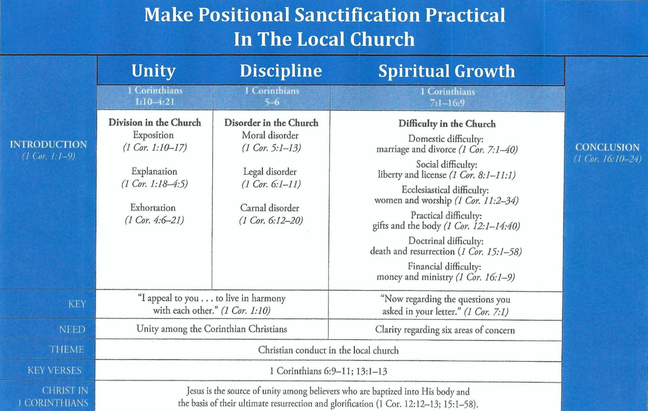
Purpose and Presentation
First Corinthians

Slide 10
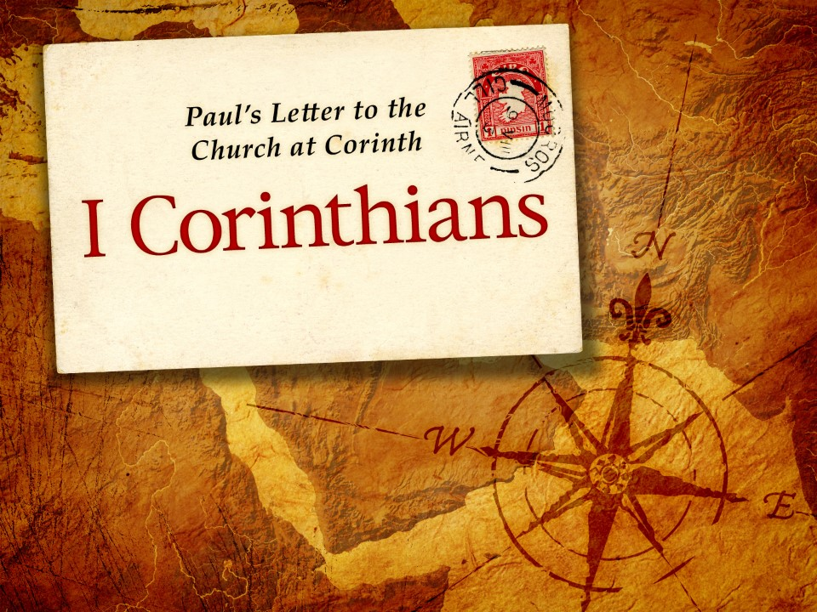
The Foolishness of the Cross – 1:18-31

Slide 11
1 Corinthians - Lesson Overview
Swindoll … opens this study with a story, depending on your preference, leaves you either cheering or booing.
“Roy Riegels, a football player for the University of California, in the 1929 Rose Bowl picked up a fumble and ran 65 yards only to discover he had run the wrong way. The wrong fans cheered and in the end the wrong team won.”
The same thing can happen to a church, or to a Christian. Sometime we can spend a massive amount of time helping the wrong side without realizing it.
The Corinthian church had fallen into this category, without realizing it, these muddled, misguided Christians were helping the wrong side.

Slide 12
1 Corinthians - Lesson Overview
So the apostle Paul, like a master coach, opens God’s playbook and explains His truth as something they never would have invented:
“A crucified Messiah and a crucified self as the way to life everlasting.”
After Paul planted the church in Corinth, the congregation gradually deteriorated into an arrogant, wrongheaded, squabbling community on the verge of losing its testimony as a God-glorifying local body of Christ.
They stuck their noses up in the air and bragged about incidental things like who had baptized them (1:12-15).

Slide 13
1 Corinthians - Lesson Overview
Pride led them to elevate human rhetoric and cleverness over the good news of Jesus’ death and resurrection.
In short, the gospel’s heart was being trampled by the feet of humanistic pseudo-intellectualism. A fleshly viewpoint that needed a face-to-face with the true meaning of the cross of Jesus Christ.

Slide 14
1 Corinthians 1:18 - 19
¹⁸ For the message of the cross is foolishness to those who are perishing, but to us who are being saved it is the power of God. ¹⁹ For it is written: “I will destroy the wisdom of the wise, and bring to nothing the understanding of the prudent.”

Slide 15
1 Corinthians 1:18 - 19
In 1:18, Paul begins to explain why he did not preach the gospel to the Corinthians by resorting to clever speech (1:17c).
To have done so would have required him to jettison the cross from the gospel.
Why?
Because the message of the Cross of Christ and its saving power for believers is frankly nonsensical by the world’s standards. It’s “Foolishness to those who are perishing.”
To those who had not received the forgiveness of sins through faith in Christ’s debt-cancelling death, the cross was pure folly (foolishness).

Slide 16
1 Corinthians 1:18 - 19
The idea that one perfect man could die in place of innumerable sinners—and that this sacrifice was sufficient payment, applied freely to all who believed—was about as bizarre a message as anybody in the first century would have heard.
However, for believers, Christ’s death on the cross take center stage. It is crucial for every aspect of our salvation: past, present, and future.
In 1:18, Paul’s use of “being saved” suggests that he has at the forefront of his mind “Progressive Sanctification” in which believers are delivered from sin’s power through a life of cross-bearing.

Slide 17
1 Corinthians 1:18 - 19
To help us better understand the idea of “Cross-Bearing,” Jesus, in Luke 9:22-24, tells us what this aspect of present salvation from a life of disobedience and sin looks like:
“The Son of Man must suffer many things, and be rejected by the elders and chief priests and scribes, and be killed, and be raised the third day . . . If anyone desires to come after Me, let him deny himself, and take up his cross daily, and follow Me. For whoever desires to save his life will lose it, but whoever loses his life for My sake will save it.”
Swindoll says … “I doubt most people today understand what Jesus meant when He talked about taking up our cross daily, because we don’t see the cross as a means of execution.”

Slide 18
1 Corinthians 1:18 - 19
In the Roman Empire, however, people sentenced to die by crucifixion had to carry at least a section their crosses through the city to their appointed place of public execution.
This practice demonstrated to all observers that the condemned rebels had finally submitted to the state – in death.
So Jesus meant, “If you want to follow My path, and you want to be a genuine disciple of Mine, you must be willing – every day – to put to death your stubborn will and personal desires (Luke 9:23).”
“And you must readily accept the Father’s will – as I have – over your own.”

Slide 19
1 Corinthians 1:18 - 19
This message of the cross sounds absolutely foolish to the unbeliever.
Both the idea that the Son of God would voluntarily die for sinners and that saved sinners should voluntarily die to themselves for the sake of discipleship.
The word in 1:18 used for “foolishness” is “mōría” from which we get the English word “moron.”
Swindoll suggest … “From the world’s perspective, only a moron would believe the message of the cross and live a life of self-sacrifice in light of it.”
“But for believers who are being delivered from a life of hopeless bondage to sin by taking up their crosses and following Christ, the cross is the power of God (1:18).”

Slide 20
1 Corinthians 1:18-19
Talk about countercultural! God’s message of salvation and sanctification flies in the face of all man-made religious, social, and psychological expectations.
Paul knew how contrary this theology of the cross must have sounded to his readers in Corinth; he knew that the last thing they wanted to do was to take up their crosses by surrendering their right, privileges, and benefits.
So Paul wisely backs up his “foolishness” message of the cross with this important Old Testament truth.
“Rather than respond to God’s call to repent and turn to Him for supernatural deliverance, Israel followed the human wisdom of politicians and compromised her standards. And looked for wisdom in the intellect of men that resulted in absolute tragedy” (2Kings 17).

Slide 21
1 Corinthians 1:18 - 19
“Therefore, behold, I will again do a marvelous work among this people, a marvelous work and a wonder; for the wisdom of their wise men shall perish, and the under-standing of their prudent men shall be hidden” (Isa 29:14).
By alluding to this passage from Isaiah, Paul reminded the Corinthians that God’s plans and methods “destroy the wisdom of the wise” and set aside “the cleverness of the clever” (1:19).
Even though the message of the cross may seem “moronic,” it’s the power of God for salvation and the only key to an abundant life.

Slide 22
1 Corinthians 1:20 - 25
²⁰ Where is the wise? Where is the scribe? Where is the disputer of this age? Has not God made foolish the wisdom of this world? ²¹ For since, in the wisdom of God, the world through wisdom did not know God, it pleased God through the foolishness of the message preached to save those who believe. ²² For Jews request a sign, and Greeks seek after wisdom; ²³ but we preach Christ crucified, to the Jews a stumbling block and to the Greeks foolishness, ²⁴ but to those who are called, both Jews and Greeks, Christ the power of God and the wisdom of God. ²⁵ Because the foolishness of God is wiser than men, and the weakness of God is stronger than men.

Slide 23
1 Corinthians 1:20 - 25
As if pointing his finger across the crowd of squabbling believers in Corinth, Paul probes the congregation: “Where is the wise man, Where is the scribe, Where is the debater if this age?” (1:20).
In light of God’s act trumping human reason with the message of the cross, none of the Gentile geniuses, Jewish scholars, or Greek intellectuals amounted to anything.
Not only could the greatest sources of wisdom in the world contribute nothing beneficial to the cross, but their attempts at refining, intellectualizing, or rationalizing the message only undermined it.
Because, God had so thoroughly turned the tables on the wisdom of the world, it was rendered “foolish” (1:20).

Slide 24
1 Corinthians 1:20 - 25
The greatest pursuits of worldly wisdom inevitably fail to lead to the one true God. Paul says in 1:21, “The world through its wisdom did not come to know God.”
Even today many brilliant astronomers peer into space with the most powerful telescopes ever invented, yet their intensive scouring of the universe never leads them beyond the created realm to the Creator Himself.
On the other extreme, many scientists focus their powerful microscopes on the smallest particles of matter, seeking some kind of explanation for the order, the complexity, and the beauty of the physical universe, yet they also fail to find the all-powerful and all-wise Orderer Himself.

Slide 25
1 Corinthians 1:20 - 25
Only through the “foolishness of the message” can we come to know God as He truly is (1:21).
When Paul calls the message of the gospel “foolish,” he writes from the world’s perspective. From God’s perspective and from that of the believer, the gospel is true and ultimate wisdom.
Paul amplifies his point, describing the reasons both Jews and Greeks find themselves confused by the simple message and dumbfounded by the obvious truth (1:22).
Jews demanded proof in the form of signs and wonders that would validate the authenticity of the message.

Slide 26
1 Corinthians 1:20 - 25
Greeks pursued rationalistic explanations – intellectual and logical proofs that any thinking person could compute on their own.
Both of these responses to the gospel appear reasonable from the human perspective. Yet they fail to lead people to Christ.
The Jews looked for a victorious warrior Messiah, who would usher in the kingdom by miraculously vanquishing the Roman Empire and restoring the glories of the Davidic Kingdom (Matt 27:42; Luke 1:68-75; 24:21; Acts 1:6).
Instead, Jesus had performed his miracles among smaller groups of the disenfranchised, despised, and rejected .

Slide 27
1 Corinthians 1:20 - 25
He preached a message of repentance, righteousness, and peace. He called for self-sacrificial surrender to the will of God, following in His footsteps – even to the cross, if necessary.
He refused to perform miracles on demand (Matt 12:38-41), alienating the religious zealots who were eager to overturn the political establishment for their own vindication.
How could the Jews believe that this Jesus was their long-awaited Savior?
This peasant preacher of Nazareth was a “letdown” in their eyes, and so they stumbled because of misguided expectations (1 Cor. 1:23).

Slide 28
1 Corinthians 1:20 - 25
Paul concludes his thoughts on the “wise folly” of the cross (1:24-25).
In the world’s eyes, the gospel of Jesus Christ is foolishness; but to those of us who believe, Christ is the power and wisdom of God personified (1:24).
In fact, “the foolishness of God is wiser than men, and the weakness of God is stronger than men” (1:25).

Slide 29
1 Corinthians 1:26 - 31
²⁶ For you see your calling, brethren, that not many wise according to the flesh, not many mighty, not many noble, are called. ²⁷ But God has chosen the foolish things of the world to put to shame the wise, and God has chosen the weak things of the world to put to shame the things which are mighty; ²⁸ and the base things of the world and the things which are despised God has chosen, and the things which are not, to bring to nothing the things that are, ²⁹ that no flesh should glory in His presence. ³⁰ But of Him you are in Christ Jesus, who became for us wisdom from God— and righteousness and sanctification and redemption— ³¹ that, as it is written, “He who glories, let him glory in the Lord.”

Slide 30
1 Corinthians 1:26 - 31
Now Paul personalizes the contrast between the “wisdom” of the world and the “folly” of the gospel (1:26).
He says … “Just look at your own calling, believers; not many [of you were considered] wise according to human standards, not many powerful or influential, not many of high and noble birth” (AMP).
The nature of the gospel’s power through what the world perceives as “foolishness” should have been evident to in the humble backgrounds of the believers themselves.
Paul reminds the Corinthians that, according to human standards, only a few of them were considered wise, mighty, or noble.

Slide 31
1 Corinthians 1:26 - 31
While the Corinthians had their share of intellectual superstars, for the most part, the Corinthians Christians couldn’t boast in their worldly wisdom, riches, or pedigrees.
In light of the message of the gospel, Paul reminds us that without God all human beings – from the cultural “crème de la crème” to the bottom of the social barrel – are vagabonds living in the dumps of human depravity.
Neither the upper echelons of society nor the lowest rungs of the ladder can boast in any merit before God, who calls us by His own grace and mercy, not based on our own worthiness.

Slide 32
1 Corinthians 1:26 - 31
Despite our filthy condition, God mercifully reaches down, plucks us from the garbage heap, and begins His process of transforming us into valuable pieces of art.
So when God chose to save people from among the dregs of society, he shamed the wise and powerful (1:27).
By building His kingdom from the despised and rejected, the political, social, cultural, religious, and intellectual “have-nots” (1:28), God sends the world a game-changing message: “No flesh can boast before God” (1:29).
In fact, the cross levels the playing field, sealing all as guilty before a just and holy God (Rom 3:23).

Slide 33
1 Corinthians 1:26 - 31
So what’s the solution to this universal condemnation of all? It’s the free gift of “Grace.”
Paul says … “For by grace you have been saved through faith; and that not of yourself, it is the gift of God: not as a result of works, so that no one may boast” (Eph2:8-9).
“Grace” should remind us that the Master, not the masterpiece, should always receive the praise, and the glory. God has no tolerance for the proud, the arrogant, nor the self-sufficient.
By debasing the arrogant, He humbles them, making them acknowledge their poverty and enabling them to receive His great riches (Dan 4:28-37).

Slide 34
1 Corinthians 1:26 - 31
Now! Paul contrasts the Corinthians’ spiritual deficiencies with the sufficiency of Christ. Everything humans lack because of their depravity and finitude is provided for them in Jesus Christ. He is “wisdom from God, and righteousness and sanctifications, and redemption” (1:30).
The world looks for heros, but God looks for the humble. The world praise power, prestige, and wealth; God turns our attention to Christ.
People love to rise through the ranks, to be exalted by society, to be rewarded with riches, but God has given His Son preeminence over all creation and promises us a place with Christ in the heavenly places, enjoying the same exaltation and riches through Christ alone (Eph 2:6-7).

Slide 35
1 Corinthians 1:26 - 31
Left to ourselves, we are nothing, but in Christ, we are invaluable. The difference lies in Him, not in us. Thus we should never boast in our own merit before God. Rather if we boast at all, we can only “boast in the Lord” (1:31).
Paul’s final exhortation to boast in no thing, and no one but the Lord echoes a powerful passage in Jeremiah.
Thus says the Lord: “Let not the wise man glory in his wisdom, Let not the mighty man glory in his might, Nor let the rich man glory in his riches; But let him who glories glory in this, That he understands and knows Me, That I am the Lord, exercising lovingkindness, judgment, and righteousness in the earth. For in these I delight,” says the Lord.

Slide 36
Applications
Of the
lesson
The Wisdom Of God’s Folly

Slide 37
Application – The wisdom of God’s Folly
In closing Swindoll illustrates the reconciling work of Christ, by using a drawing of a gulf connected by a bridge made of the cross, showing a man walking across the bridge by faith in Jesus, to the other side.
Let’s review the features of this drawing before we view the drawing:
GULF – God and man.
LADDER – Humans attempts to get to God.
BRIDGE – Faith in Jesus cross.
MAN – Walking by faith.

Slide 38
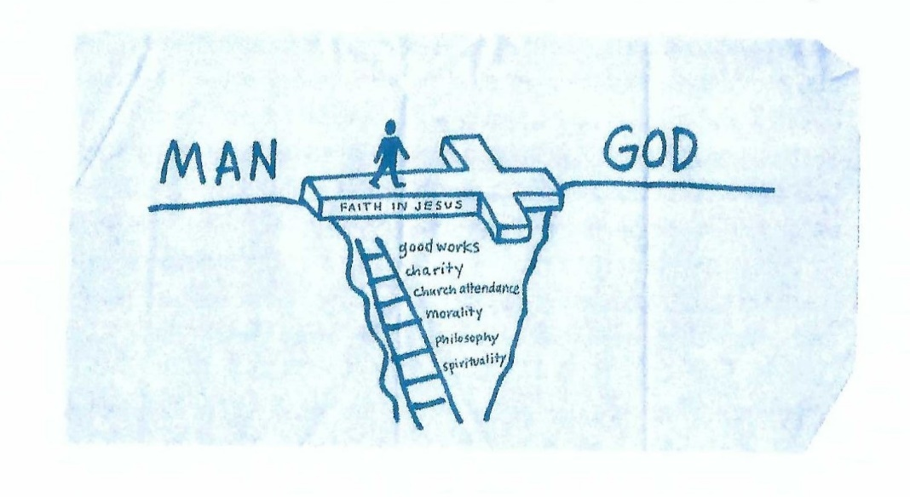
Application – The wisdom of God’s Folly

Slide 39
Application – The wisdom of God’s Folly
Swindoll said … During a meeting with a prominent physician he had opportunity to share the gospel so he drew an illustration on a napkin.
“I finished the drawing in about four minutes, turned it around, slid it across the table and ask, “What do you think?”
Without much thought, that physician blinked then blurted out, “In a million years I could never believer something so illogical and simplistic!”
That’s the response of a man who couldn’t fit the simplicity of the gospel into his sophisticated philosophical framework.

Slide 40
Application – The wisdom of God’s Folly
I feel sorry for the intellectual whose own mental acumen hardened by stubborn pride, becomes a stumbling block to salvation.
Let’s admit it! Dismissive reactions to the gospel from highbrow skeptics and cynical critics can tempt us to shy away from sharing the good news of Christ’s life-changing death and resurrection.
In fact, a “that’s stupid!” or a “how could you believe something like that?” response can feel like a kick in the gut and make us ask ourselves the same question.

Slide 41
Application – The wisdom of God’s Folly
Is the gospel too simplistic and ridiculous to believe?
Not at all!
Let’s remember that cultured criticisms of Christian claims have been around since the beginning of the church.
Around A.D. 210, the Christian apologist Tertullian of Carthage engaged in a fierce defense of the faith against heretics who believed the biblical gospel was too unsophisticated to accept “as is.”
They attempted to soften its rough edges, modify its offensive elements, and transform Christianity into something more philosophically pleasing to the elite thinkers of the day.

Slide 42
Application – The wisdom of God’s Folly
In response to the charge that the message of incarnation, death, and resurrection of the God-man was utter folly, Tertullian wrote,
“It is of course foolish, if we are to judge God by our own conceptions. But … consider well this scripture, if indeed you have not erased it: ‘God has chosen the foolish things of the world, to confound the wise.’”
Tertullian, like Paul, reminds us that the world’s standards of intellectual respectability are irrelevant when it comes to the truth of God.
In fact, he turned the tables on the skeptics and critics. He said we should believe the claims of the gospel not in spite of their intellectual absurdity, but because of it.

Slide 43
Application – The wisdom of God’s Folly
Tertullian argued that no reasoning human would ever make up something like the crucified God-man and try to preach it around the world, unless it were true.
If humans simply invented the gospel, they would have concocted something much more philosophically respectable – something like the perversions of the faith spouted by the heretics.
Tertullian famously said, “The Son of God was crucified; and the Son of God died; it is by all means to be believed, because it is absurd. And He was buried, and rose again; the fact is certain, because it is impossible.”

Slide 44
Application – The wisdom of God’s Folly
Each of us needs to recommit to standing tall and proud on the “absurdity” of the gospel. We shouldn’t be ashamed of it.
All of us who have experienced reconciliation know that it is the power of God for salvation (Rom1:16). So what if worldly minded unbelievers scoff at it? Let them scoff!
Critics will mock us for believing it. So be it! Instead of backing down and cowering in fear, let’s renew our commitment to embrace the “ridiculous,” knowing that “the foolishness of God is wiser than men” (1:25).

Slide 45



Slide 46
NEXT CLASS – 31 May 2023
Book of First Corinthians
Before next class, read the below chapters in the NKJV and in one other versions of the Bible, i.e., KJV, NRSV, NIV, CEV, etc …
Chapter 2:1 – 16
“The Hidden Depths of God … Revealed!”

